Slide 1
IS 362 FINAL Project
Top Movie Budgets Compared to Critic Scores

Slide 2


Goal: to see if there is a relation between the budget spent for the all time top budgeted films and the movie scores from audiences (IMDB) and critics (Rotten Tomatoes)

Slide 3

Sources
Wikipedia page with table of top movie budgets for all time
SQL table with IMDB and Rotten Tomatoes Scores

Slide 4
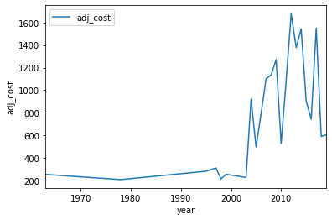

Conclusions
The amount spent on the highest budgeted movies by Hollywood is increasing over time

Slide 5
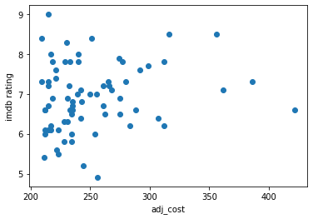
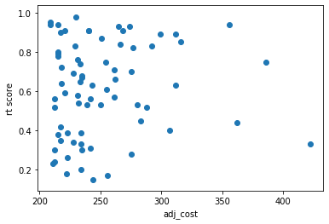
conclusions
For IMDB ratings, spending 1.5x (300 mil) doesn't mean that there will be an appreciable increase in audience ratings.
Rotten Tomatoes, we can see that lots of movies around the 200-250 million budget mark are getting high critical scores, and increasing the budget is not a guarantee of high scores

Slide 6

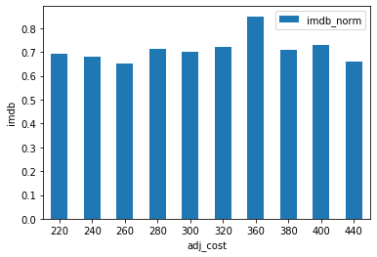
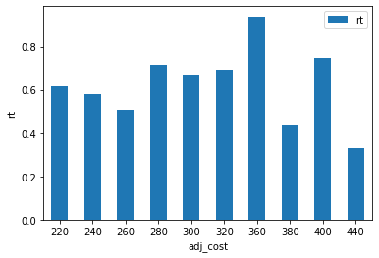
Conclusions
IMDB user score stays in the same range no matter what the average budget is, so it doesn't make sense to increase the budget to get a better user score
Average budgets compared to Rotten Tomatoes scores shows that budgets at the higher end may in fact lead to a lower score

